Slide 1
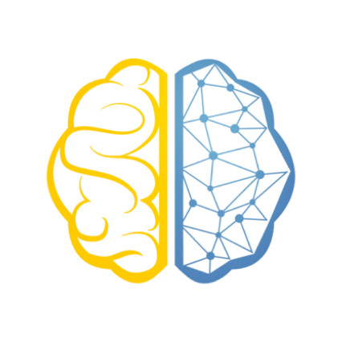
Data Science 01
COMP 3122
Dr. Reza Dibaj

Slide 2
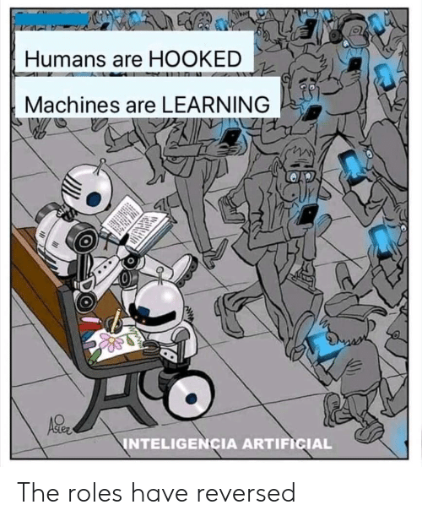

Slide 3
Previous Semester Resources
All the resources are available on the following link:
https://github.com/jakevdp/PythonDataScienceHandbook
The main reference (reading online):
https://jakevdp.github.io/PythonDataScienceHandbook/
Book structure - Python libraries
IPython & Jupyter
NumPy
Matplotlib
Pandas
Scikit-learn

Slide 4
My Contact Info & Office Hours
Email: Reza.Dibaj@GeorgeBrown.ca
Telegram: @DrRezaDibaj
Link to join the Group: (George Brown - Data Science - Fall 2022)
https://t.me/+MeicHiT1nbY2Mjgx
Office hours: Upon the request

Slide 5
Marking Scheme
Assignments 4x6% 24% (Individual)
Final Project 10%
Lecture Quizzes 8x1.5% 12% The best 8 out of 11 quizzes
Lab Exercises 8x1% 8% The best 8 out of 11 exercises.
Midterm Exam 21% A session after the intersession
Final Exam 25%
Bonus Marks Up to 10%

Slide 6
Why we study…
We need motivation for what we do.… for what we learn….
https://www.youtube.com/watch?v=01ZCnCXpG4A

Slide 7
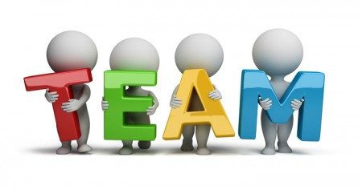
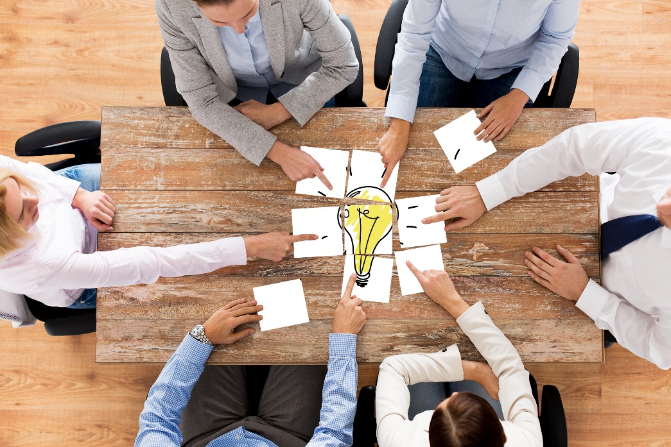
Team Making
We find our team members in one week or two.

Slide 8

Now, it is your turn…
Please let me know what you think.
As a coach, how can I be any help.
Defining a group of up to 10 members
Participating and sharing your concerns
Here is the Telegram Link for the Core Group:
https://t.me/+E-W7Ot-JkpdhZTY5
Notes:
Finding our own goals and projects…
Learning Python to the fullest…

Slide 9
This course is not about ….
General Purpose AI
Pure Big Data Concept
Cloud Computing
Notes:
https://impact.com/marketing-intelligence/7-vs-big-data/
7 Vs of Big Data:
Volume
Velocity (speed)
Variety
Variability (coffee shop example)
Veracity (accuracy)
Visualization
Value

Slide 10
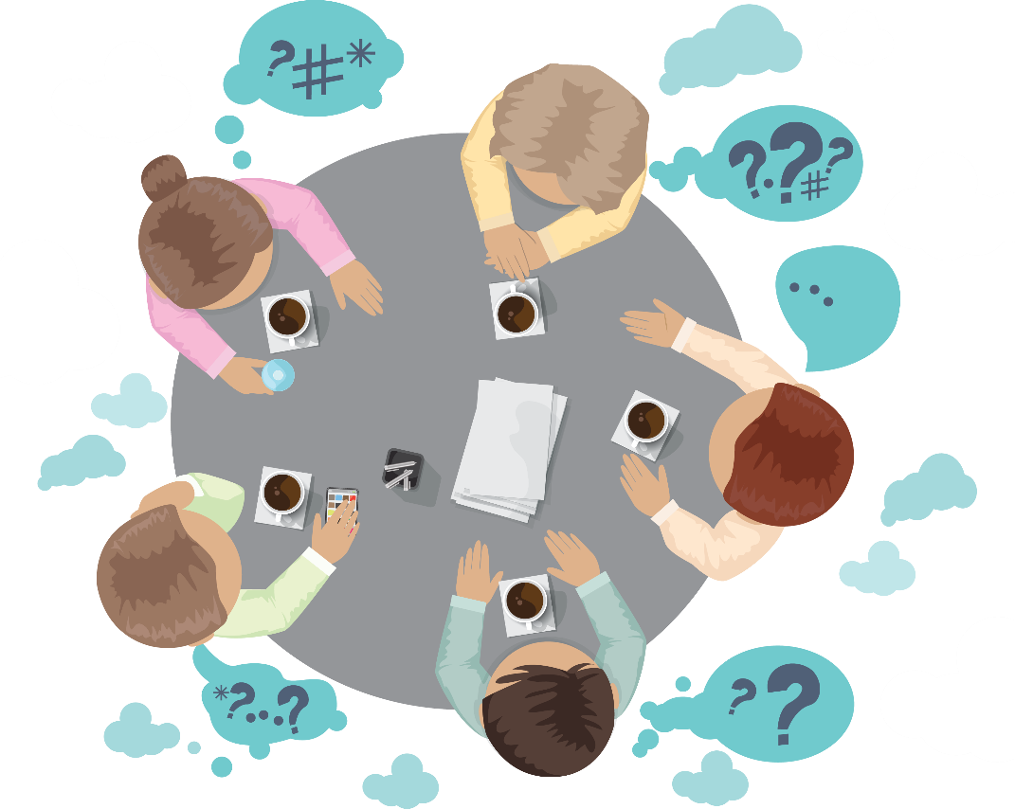
Group Discussion
Please spend a few minutes with your team members explain what the intelligence is.

Slide 11
What is intelligence?
The ability to acquire and apply knowledge and skills.
Oxford Dictionary
How do we acquire knowledge?
How does a two-year old baby learn?
Notes:
Example of flapping of wings and airplane. We DO NOT NEED TO FLAP TO FLY. So, DEEP LEARNING is not based on/inspired from human brain.

Slide 12

Quick Review of Whole IT in One Slide
Operating Systems
System S/W
Utilities
Software
Languages
Super High Level
Applications
High Level
Computer
Middle Level
Low Level
Hardware

Slide 13
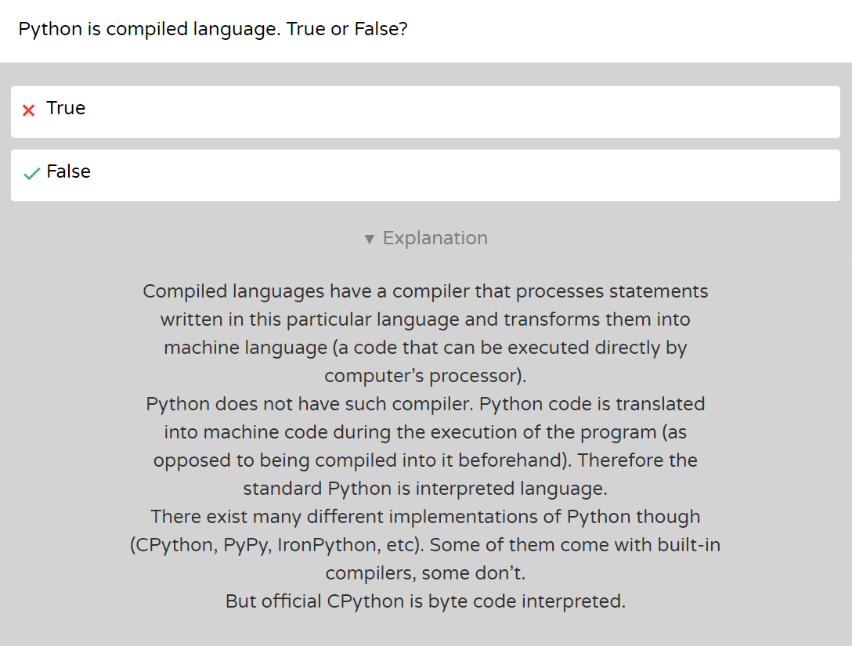
Where is Python?

Slide 14
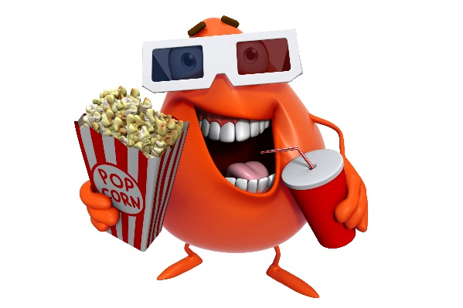
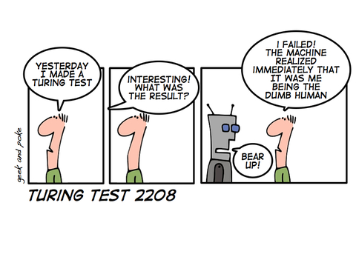
Brief history of AI
Myth of Talos (https://en.wikipedia.org/wiki/Talos)
Video 1
Turing Test – 1950s
Video 2
Video 3
Notes:
Video 3: The Greek myth of Talos (4:06)
https://www.youtube.com/watch?v=vVTA-E3G8bQ
Video 2: Turing Test (We see it in the class) (1:54)
https://www.youtube.com/watch?v=sXx-PpEBR7k
Video 3: Chloe Interview (We see it in the class) (1:37)
https://www.youtube.com/watch?v=NBjfAbZr5NY

Slide 15
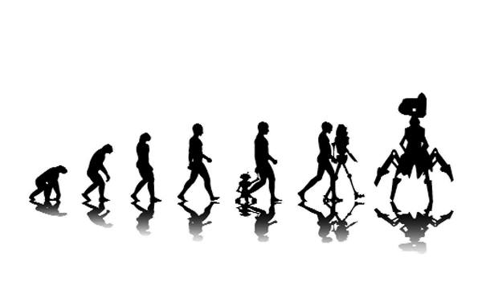

Slide 16
Brief history of AI
Asimov's Three Laws of Robotics – the 1950s
A robot may not injure a human being or, through inaction, allow a human being to come to harm.
A robot must obey the orders given it by human beings except where such orders would conflict with the First Law.
A robot must protect its existence as long as such protection does not conflict with the First or Second Laws.
Notes:
Isaac Asimov - Laws of Robotics - Extra Sci Fi - #2 (7:01)
https://www.youtube.com/watch?v=3teiT--QGzo

Slide 17
Brief history of AI
Dartmouth Conference 1956: the birth of AI
The Term Artificial Intelligence discussed and accepted
The proposal for the conference said, “The study is to proceed on the basis of the conjecture that every aspect of learning or any other feature of intelligence can in principle be so precisely described that a machine can be made to simulate it.”

Slide 18
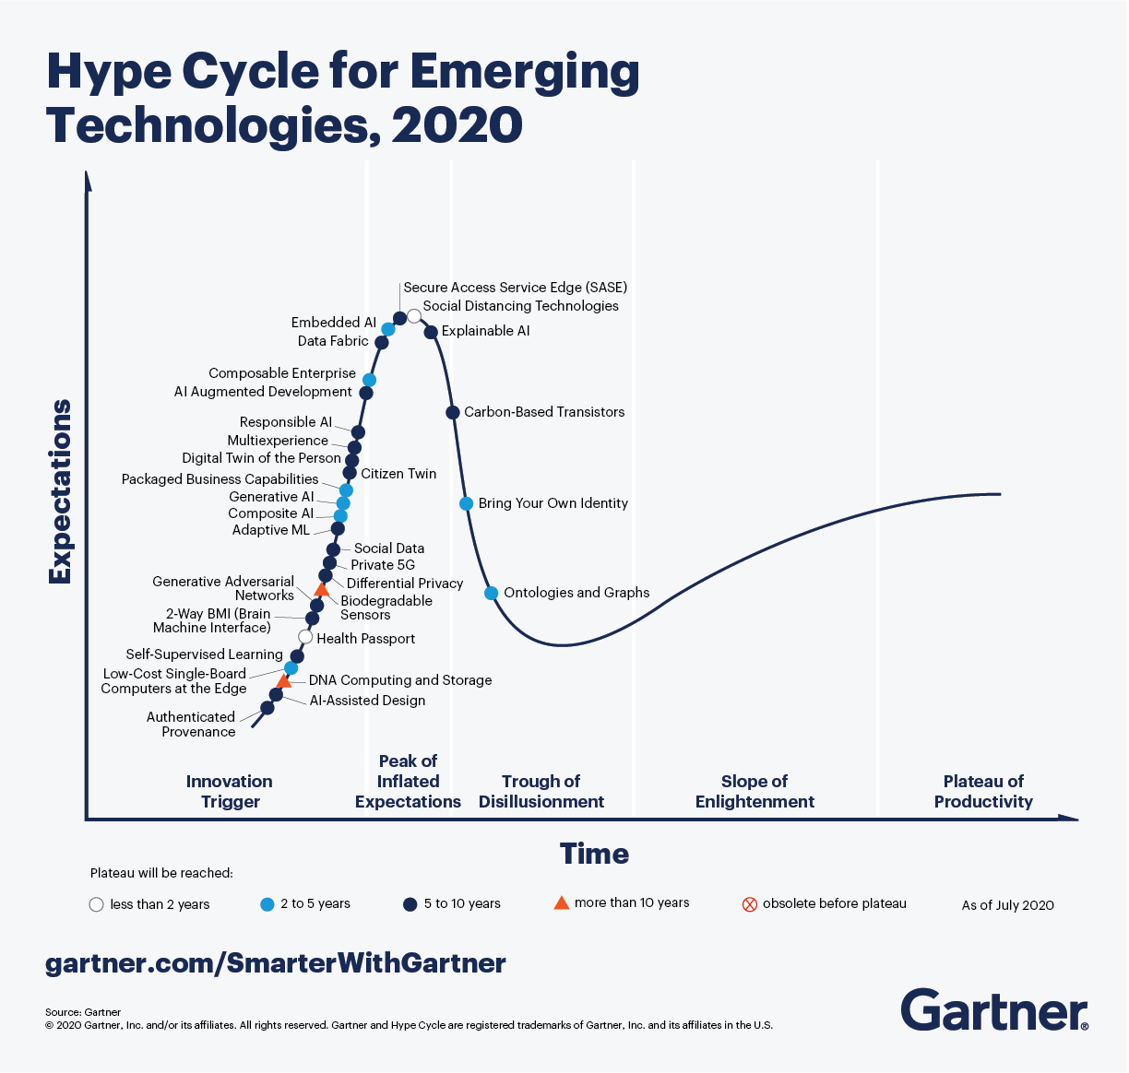
Brief history of AI
The AI winters - late 70s and 80s
Boom and bust cycles of extreme enthusiasm followed by disappointment
Notes:
Boom and bust cycle: a situation in which a period of great prosperity or rapid economic growth is abruptly followed by one of economic decline.
https://www.gartner.com/smarterwithgartner/5-trends-drive-the-gartner-hype-cycle-for-emerging-technologies-2020/

Slide 19

Brief history of AI
Modern times – Machine Learning and Deep Learning
We all hear about Machine Learning, Deep Learning, Artificial Intelligence. But how could we classify them?
Video 1
Video 2
Notes:
Video 1: (We see it in the class) (5:51)
https://www.youtube.com/watch?v=6M5VXKLf4D4
Video 2: (AMAZING Video, but no time to watch in the class☹)
https://www.youtube.com/watch?v=aircAruvnKk&t=237s

Slide 20
Why study Machine Learning (ML) & Deap Learning (DL)?
Common industrial applications of ML:
Recommendation engines (AKA Customer Recommendation System) (Netflix, Amazon)
Ad targeting (Google, Facebook, Cambridge Analytica)
Spam filtering
Credit card fraud detection
Pattern recognition in sensor data (FitBit)
Common industrial applications of DL:
Customer support
Self-driving cars
Medical care

Slide 21
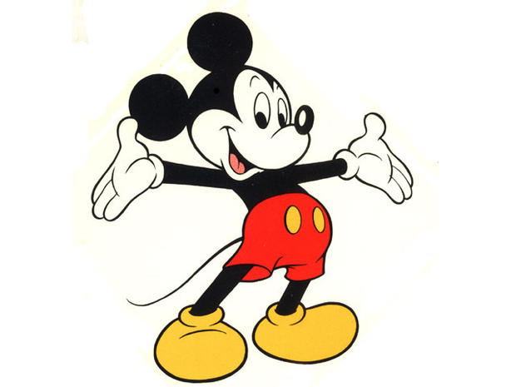
Cartoon: Learning Machine Learning
If you enjoy reading cartoons, please type C.
The following is a nice cartoon to read and learn more about Machine Learning :)
https://cloud.google.com/products/ai/ml-comic-1/
Notes:
https://cloud.google.com/products/ai/ml-comic-1/

Slide 22
Suggested Movies
Hello World Canada: The Rise of AI
The Imitation Game (2014) (Alan Turing)
2001: A Space Odyssey (1968)
Modern Times by Charlie Chaplin (1936)
The Great Dictator by Charlie Chaplin (1940)
Her
Mr. Nobody
Machina
Matrix 1 => What is Real? 1:30
Notes:
For our lab exercise for this week:
https://www.bloomberg.com/news/videos/2018-05-23/hello-world-canada-the-rise-of-ai-video
Write a summary of the clip, including five points that you can pick as the highlights of the clip.
According to the video, which country is one of the AI superpowers?
Who could not sit down at the computer desk for over a decade, and who is this gentleman? Is he recognized as the father of some parts of AI?
Who is the father of Reinforcement Learning? Where is he from, originally? Why did he come to his new country?
After watching this video, I could proudly say, I am happy that I live in Canada... How about you?
Min/Sec (1:30):
https://www.youtube.com/watch?v=EVM5-_fusjs&t=116s

Slide 23
Group Discussion
Artificial Intelligence, Machine Learning, Deep Learning and Data Science …. What are the differences between these terms?

Slide 24
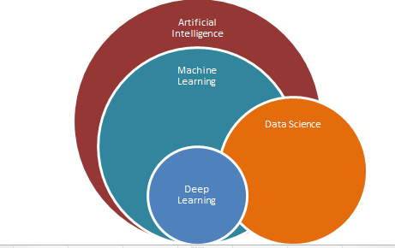
Artificial Intelligence, Machine Learning, Deep Learning and Data Science
For now, we need to have an overall view as follows….
Data Science→ Making sense of data, visualization, ….

Slide 25
Group Discussion
Please spend a few minutes with your team members explaining a few application of Machine Learning in real life. Have you ever used it?
Where?
How?

Slide 26
What is Data Science?
Movie time… YAY!
Data Science In 5 Minutes
Notes:
We see it in the class (4:37)
https://www.youtube.com/watch?v=X3paOmcrTjQ

Slide 27
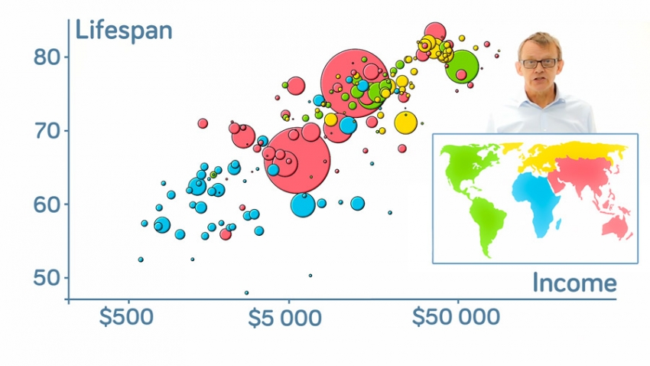
What is Visualization?
Amazing example… Let’s enjoy!
Hans Rosling's 200 Countries, 200 Years, 4 Minutes
“Let my dataset change your mindset.” -Hans Rosling
Notes:
We see it in the class
https://www.youtube.com/watch?v=jbkSRLYSojo&t=20s

Slide 28
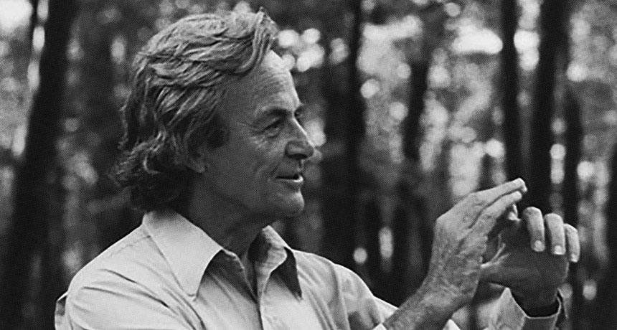
“What I cannot create, I do not understand.”- Richard Feynman

Slide 29

Skimming our Reference Book

Slide 30
Important Notes on Python
Online Jupyter:
https://jupyter.org/try
What we mostly work with:
https://colab.research.google.com/
Quick Python Recap:
https://learnxinyminutes.com/docs/python3/
On of the best quickest recap videos which was mentioned in the python official web site:
https://www.youtube.com/watch?v=_uQrJ0TkZlc
Another Python amazing resource:
https://www.youtube.com/watch?v=rfscVS0vtbw&t=25s
One of the best series of videos on pandas:
https://www.dataschool.io/easier-data-analysis-with-pandas/

Slide 31

Python Refresher (Optional Activity)
Sign up on https://checkio.org/
Solve a few problems from Elementary or Home bases…
It is cool, eh?
Create a directory for your work.
Copy & paste the code from CheckIO to a text editor (VSCode) and save it as a .py file.
Open "Anaconda Prompt", CD to your directory and run “ipython”.
Use %run yourfile.py to run and test the code.
Once all assertions pass, copy the code back to the text box on checkio.org and click on Check.

Slide 32


How to get pandas….
The best way is to install Anaconda Distribution
Which contains all pandas dependencies….
https://www.anaconda.com/distribution/
You can follow the steps in the

Slide 33


Let’s Start Some Coding….
Let’s start writing a few lines together…. Ready?
Please open 01-Python - Hello world.pptx and start reading the slides.
These amazing slides are provided by my Excellent Team Member, Sathish!

Slide 34

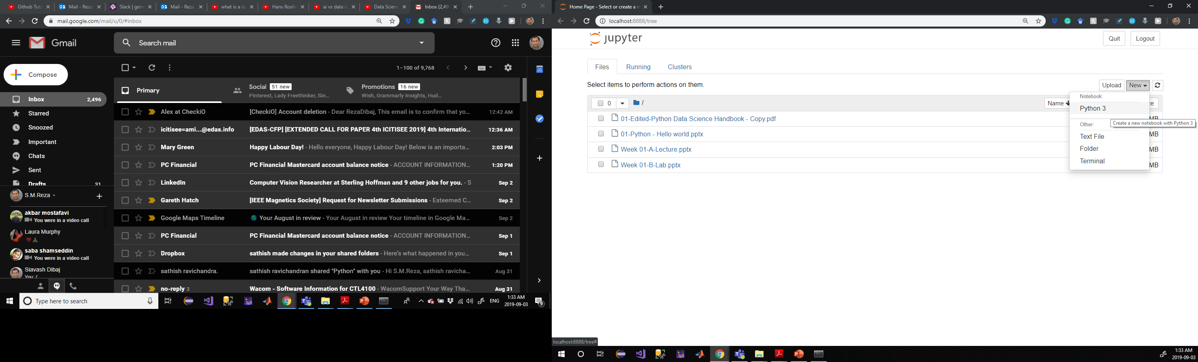
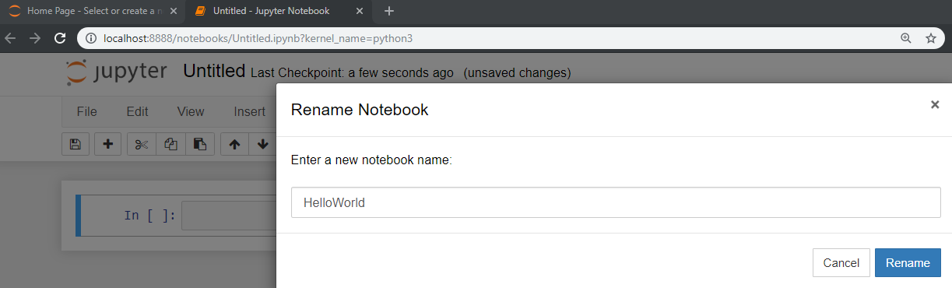
Let’s Start Some Coding….
How about a bit more Python for now?
1
2
3
4

Slide 35
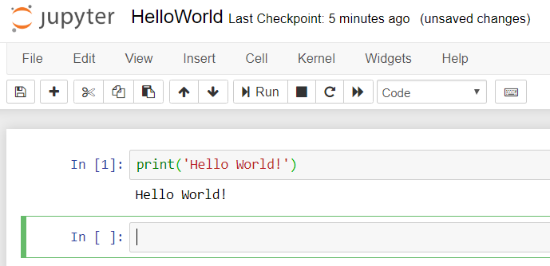
Hello World sort of thing….
Please, type the following command and press Shift + Enter to run!
Notes:
print('Hello World!')

Slide 36
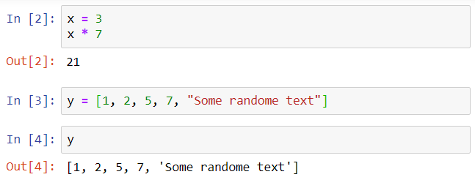
Hello World sort of thing….
We are almost there… Let’s try the following commands as well :)
Notes:
x = 3
x * 7
y = [1, 2, 5, 7, "Some randome text"]
Y

Slide 37

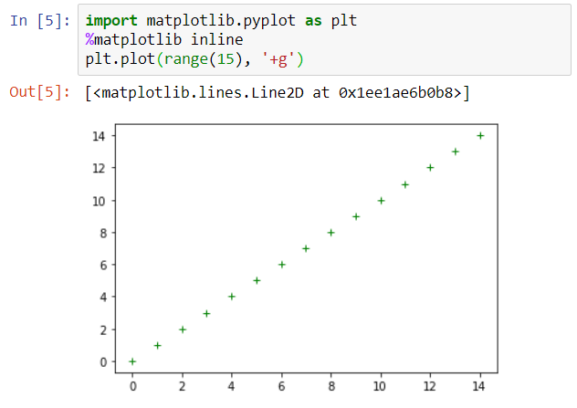
Hello World sort of thing….
Finally…. YESSSSS! We did it!
Notes:
import matplotlib.pyplot as plt
%matplotlib inline
plt.plot(range(15), '+g')

Slide 38
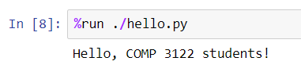
PS….
If you have hello.py in your current Jupyter Notebook path, you can type and get the following result.
Hello.py is a python file provided before and you just run it as follows:
Notes:
%run ./hello.py

Slide 39
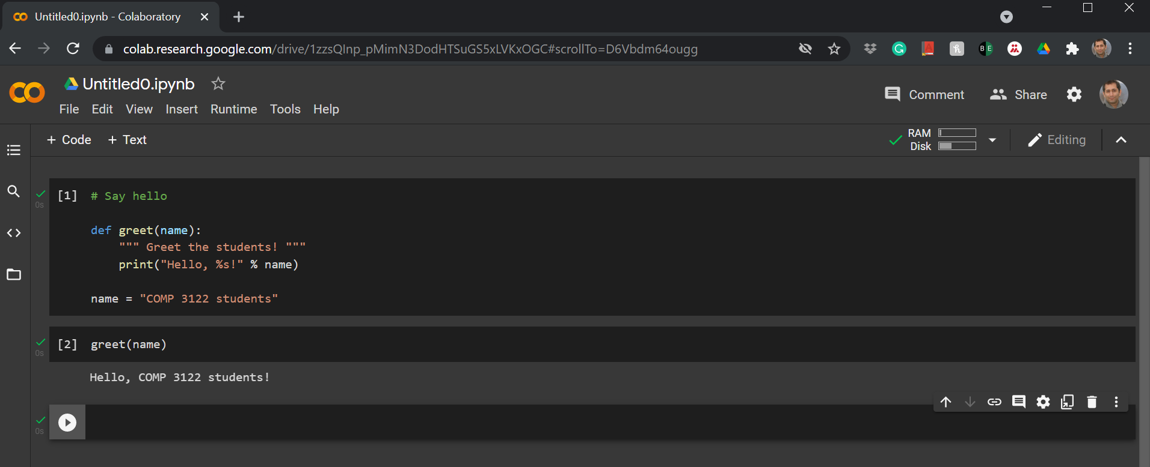
Let’s try a bit of Colab….
Notes:
# Say hello
def greet(name):
""" Greet the students! """
print("Hello, %s!" % name)
name = "COMP 3122 students"
greet(name)

Slide 40

Thank you
Question?
To be
Not to be

Slide 41

Appendix:
Installation Process of
Anaconda Distribution of Python on Windows

Slide 42
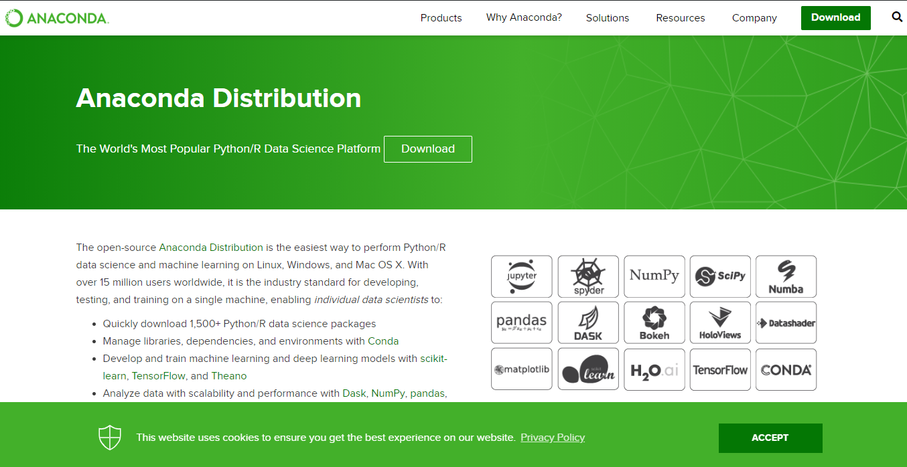
Anaconda Distribution of Python
Notes:
https://www.anaconda.com/distribution/

Slide 43
Anaconda Distribution of Python
2
1

Slide 44
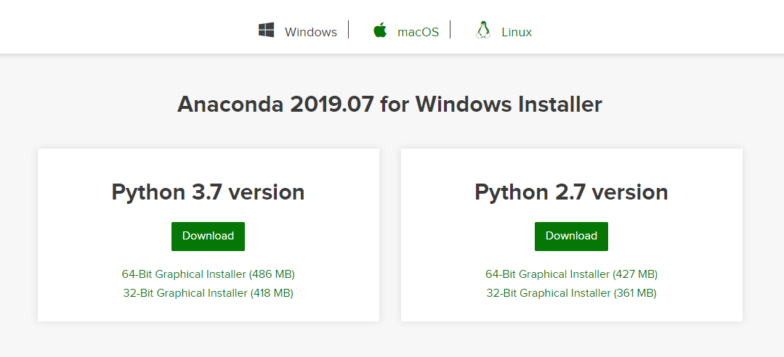
Anaconda Distribution of Python
1
2

Slide 45
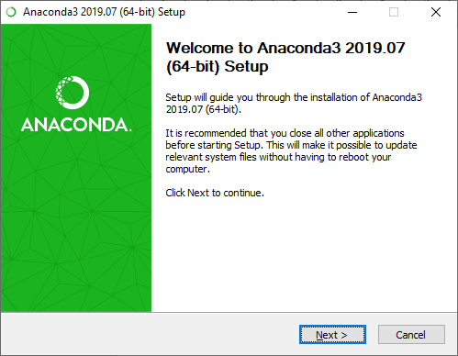
Installation Process
1
2

Slide 46
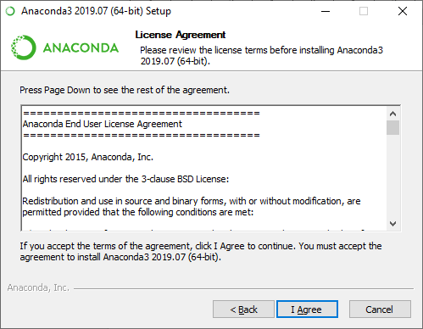
Installation Process

Slide 47
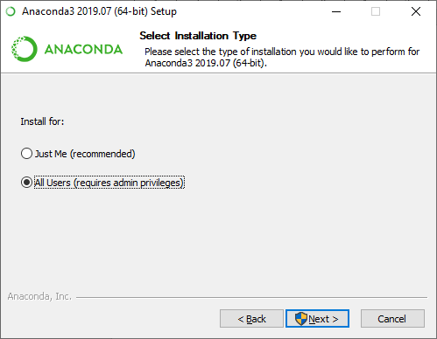
Installation Process
1
2

Slide 48
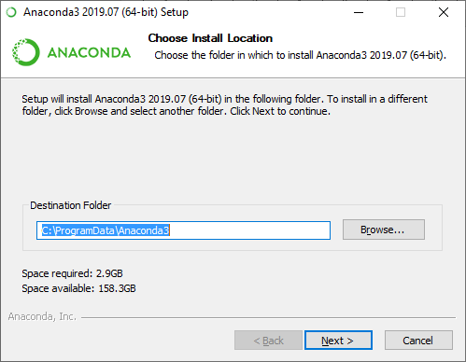
Installation Process
You can change the installation path or leave it as it is.
1
2

Slide 49
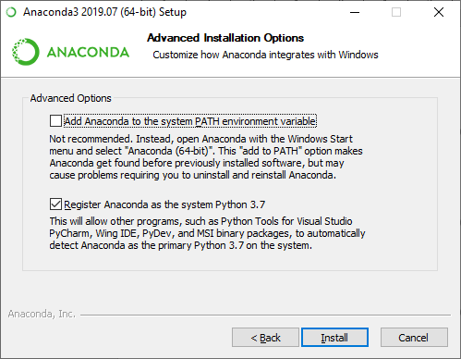

Installation Process

Slide 50
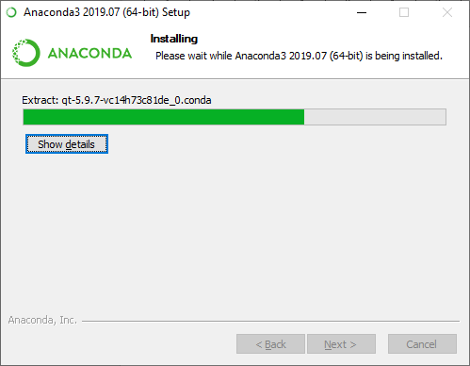
Installation Process

Slide 51
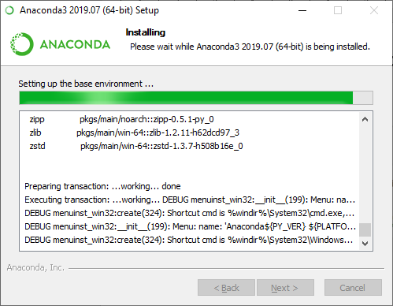
Installation Process

Slide 52
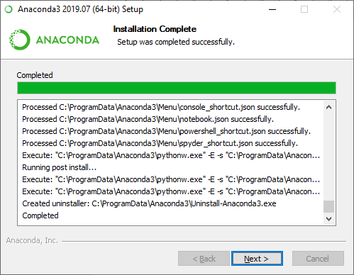
Installation Process

Slide 53
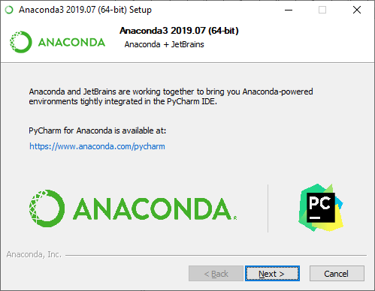
Installation Process

Slide 54
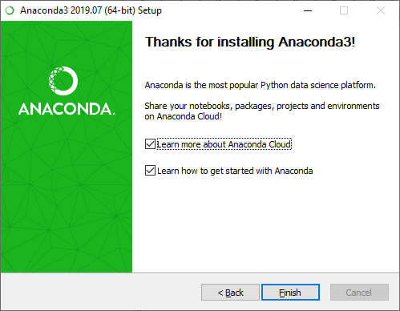
Installation Process

Slide 55
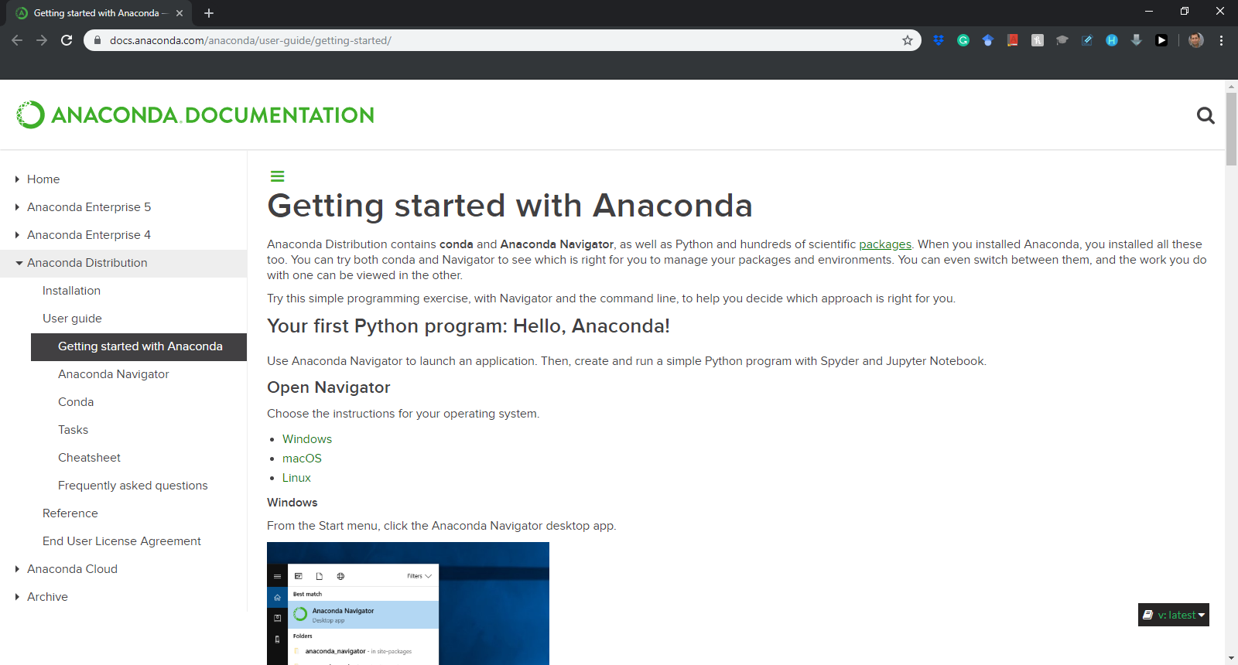
Installation Process
Notes:
https://docs.anaconda.com/anaconda/user-guide/getting-started/

Slide 56
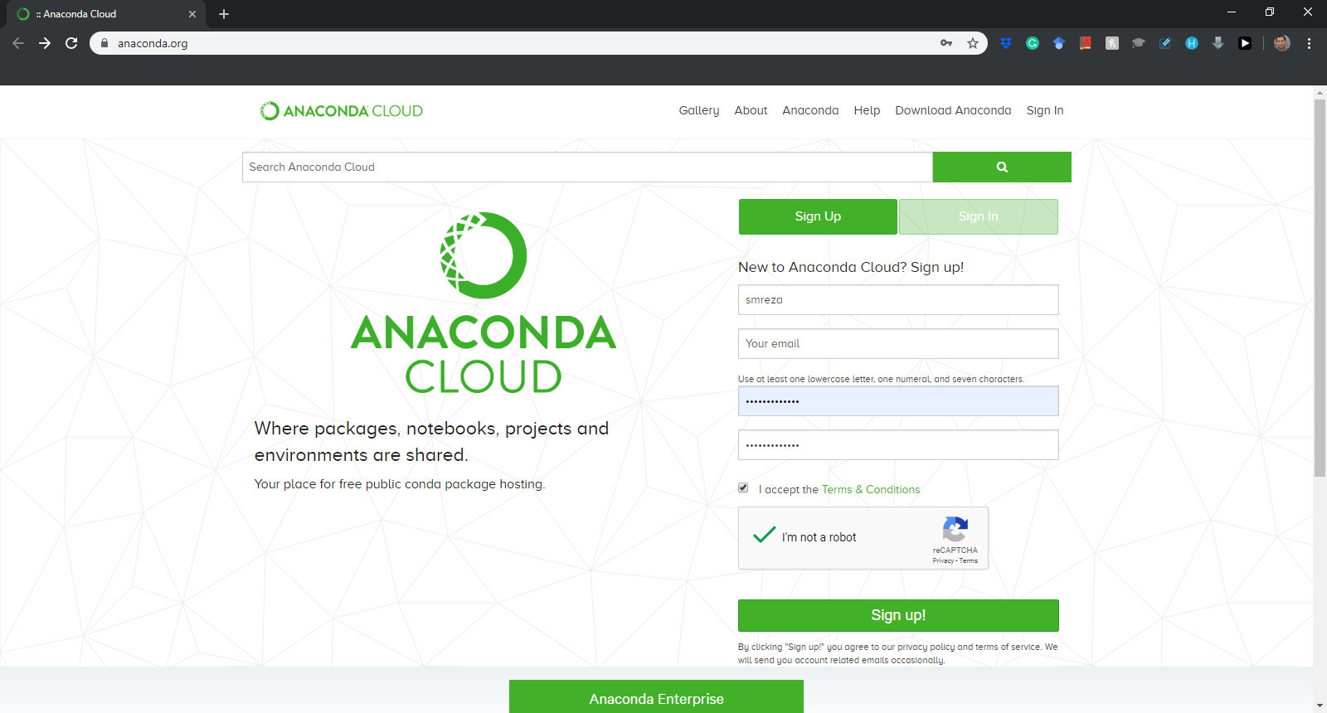
Installation Process
Sign up for the first time….
Notes:
https://anaconda.org/

Slide 57
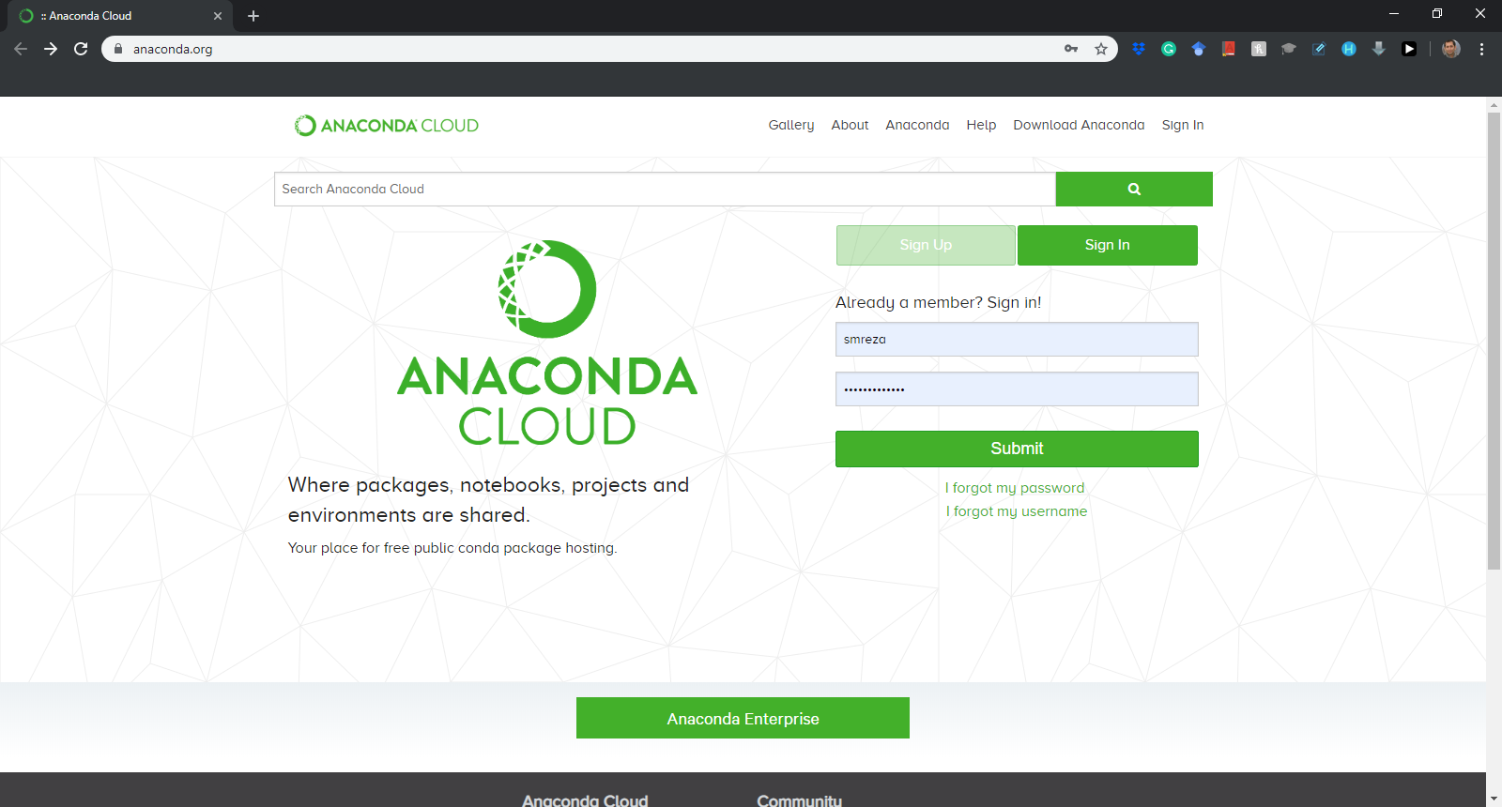
Installation Process
Sign in after the first time….
Notes:
https://anaconda.org/

Slide 58
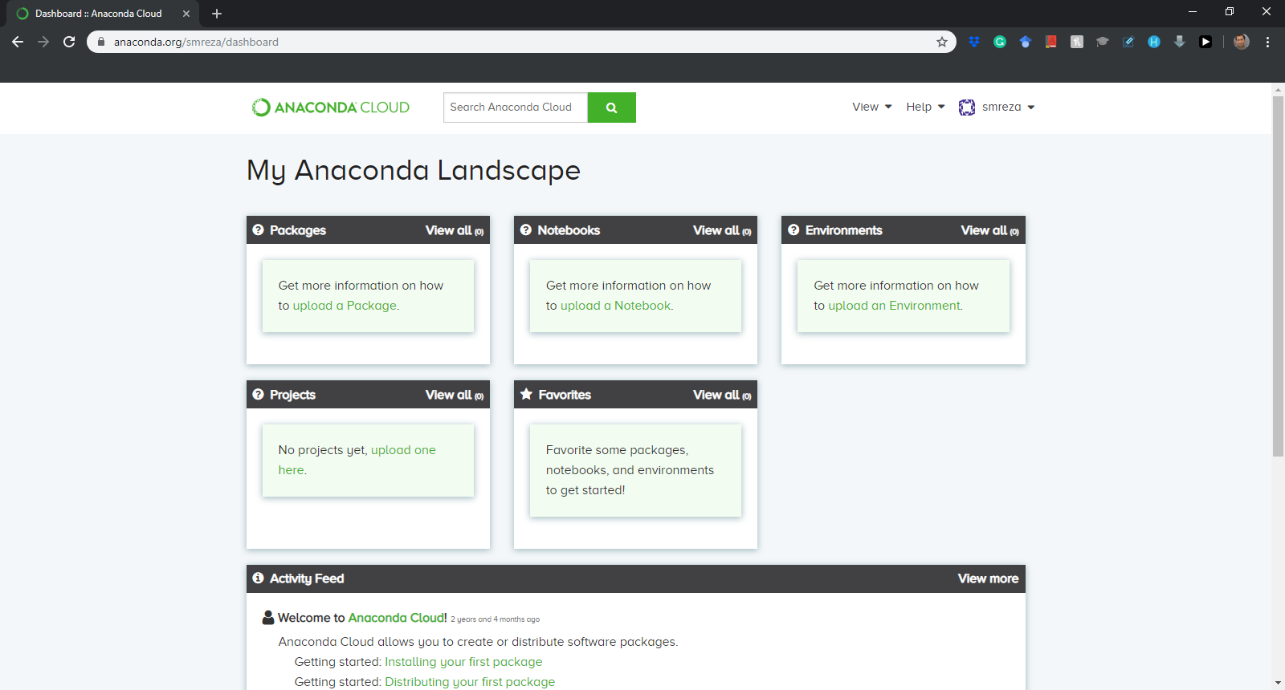
Installation Process

